Slide 1

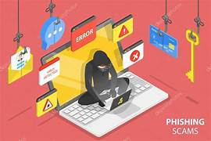

Project Title – “Phishing” - Presented By “Nutan Zine"
Internship Duration – 24-03-2025 to 24- 04-2025
Organization – “Itvedant Institute Pvt Ltd”
“Code B - Data Science Integrated Internship”

Slide 2
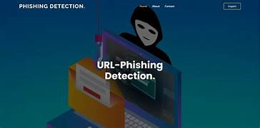
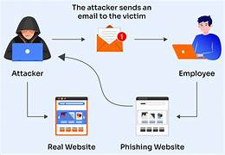
INTRODuction -
The project focuses on building a “Phishing Website Detection System” using machine learning techniques. In today’s digital age, phishing attacks have become increasingly sophisticated, posing serious threats to individuals and organizations. This project aims to develop a robust and intelligent system that can effectively distinguish between legitimate and malicious websites based on various URL and webpage-based features.

Slide 3



Objectives-
To explore and preprocess a phishing-related dataset.
To engineer meaningful features that capture patterns in phishing URLs.
Take the Target Column as “Status” & Do the Classification using “Supervized Machine Learning” Techniques.
To build and evaluate machine learning models capable of classifying websites as phishing or legitimate.
To interpret model predictions.
To deploy the model for real-time usage via a web interface.

Slide 4


Scope-
Data collection and cleaning using Python.
Feature engineering and selection based on correlation and domain insights.
Model training, comparison, and performance evaluation.
Deployment using Streamlit App4.py file and using Anaconda Prompt.
Creating an interactive UI and documentation for end users.

Slide 5
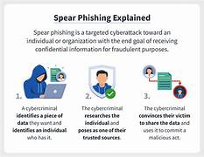

Problem Defination
Business Problem :
Phishing attacks are a major cybersecurity threat that deceive users into revealing sensitive information such as passwords, credit card numbers, or personal data. Traditional blacklist-based solutions often fail to detect newly created or cleverly disguised phishing sites in real time.
Technical Challenge :
Identifying phishing websites based on subtle and evolving patterns in URL structure and content.
Ensuring the model maintains high accuracy with minimal false positives to avoid misclassifying legitimate websites.
Balancing model complexity and explainability for practical deployment.
Importance of Solving This Problem :
User Safety: Helps protect individuals and organizations from identity theft, financial loss, and data breaches.
Scalability: A machine learning-based detection system can quickly adapt to detect new threats without relying on manual updates.
Real-Time Defense: Enables early detection and blocking of malicious websites before damage is done.

Slide 6



Project Workflow – Lifecycle Overview
End-to-End Workflow Stages :
Data Collection :
Acquired a “Phishing Detection Dataset” from a “Code – B Integrated Internship”
Verified dataset quality and structure.
Data Preprocessing :
Handled missing values and standardized features.
Encoded categorical variables and normalized numerical fields.
Feature Engineering :
Created new features (e.g., URL length, Google Index, Web Traffic).
Performed correlation analysis and feature selection to improve model efficiency.
Model Building :
Trained multiple machine learning models (Random Forest, XGBoost, etc.).
Tuned hyperparameters for optimal performance.
Evaluation :
Used accuracy, precision, recall, F1-score, and ROC-AUC to compare models.
Selected the best-performing model based on metrics and consistency.
Deployment :
Developed a web interface using “Anaconda Prompt”.
Deployed locally and/or on the cloud for real-time predictions.

Slide 7

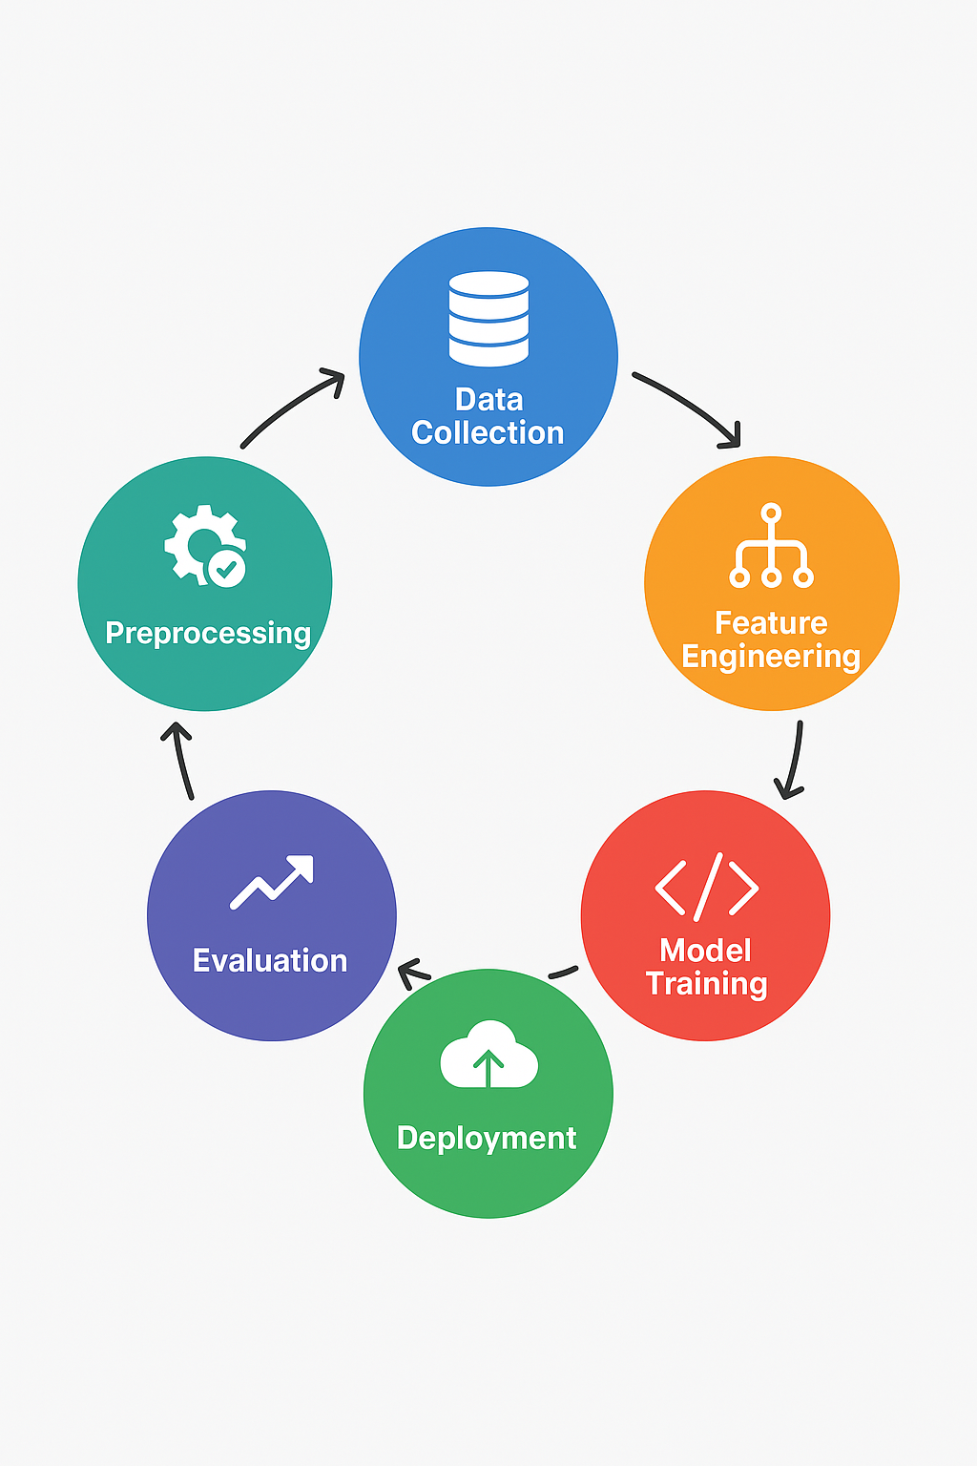
Visual Workflow Flowchart or Timeline :)
Flowchart Format :
Data Collection → phishing URLs
Preprocessing → Cleaning, encoding
Feature Engineering → Correlation, new features
Model Training → Random Forest, XGBoost
Evaluation → Accuracy, ROC-AUC
Deployment → streamlit APP4.py, Anaconda Prompt, user interface.

Slide 8


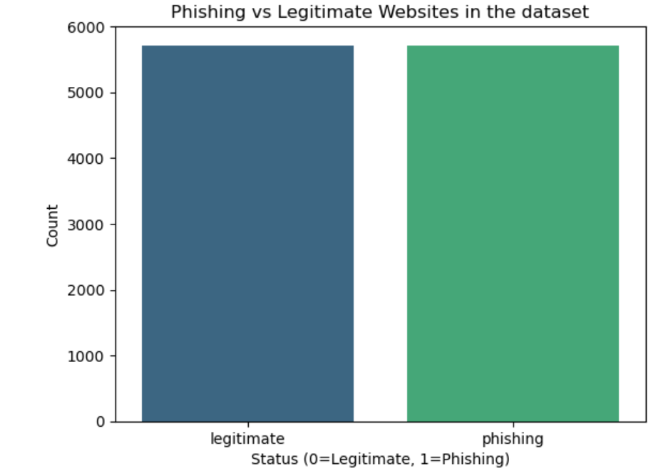
Summary of Findings :
Visual Highlights :
The dataset contains both categorical and numerical features related to website URLs.
Several features showed strong separation between phishing and legitimate sites.
Imbalanced distribution observed in a few features (e.g., abnormal URL usage, presence of @ symbol).

Slide 9


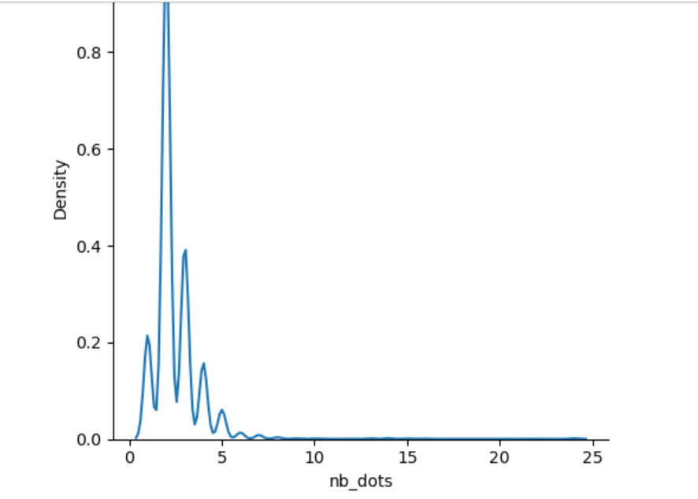
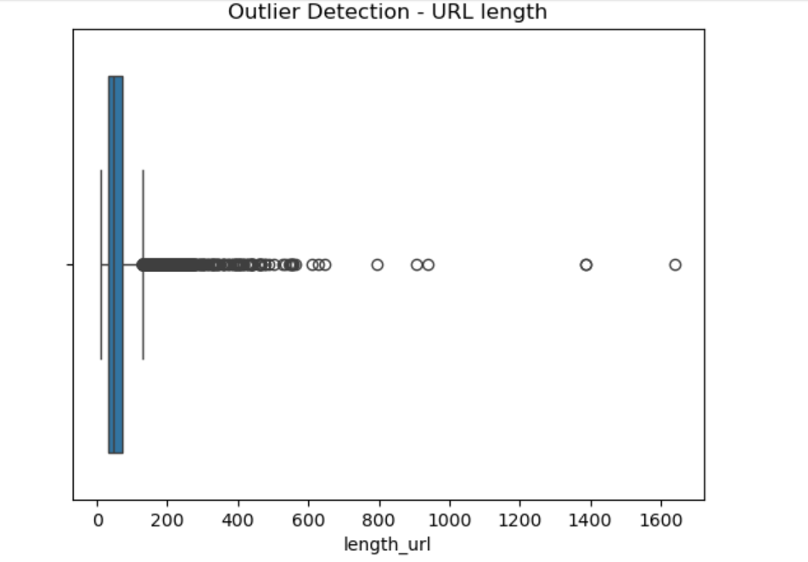
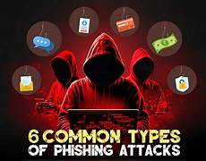
H
Distribution Plot Showing the KDE (Kernel Density Estimator) By nb_dots
Boxplot showing the Outlier Detection Of URL Length.

Slide 10
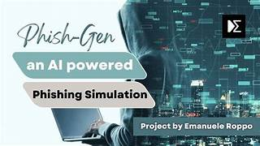

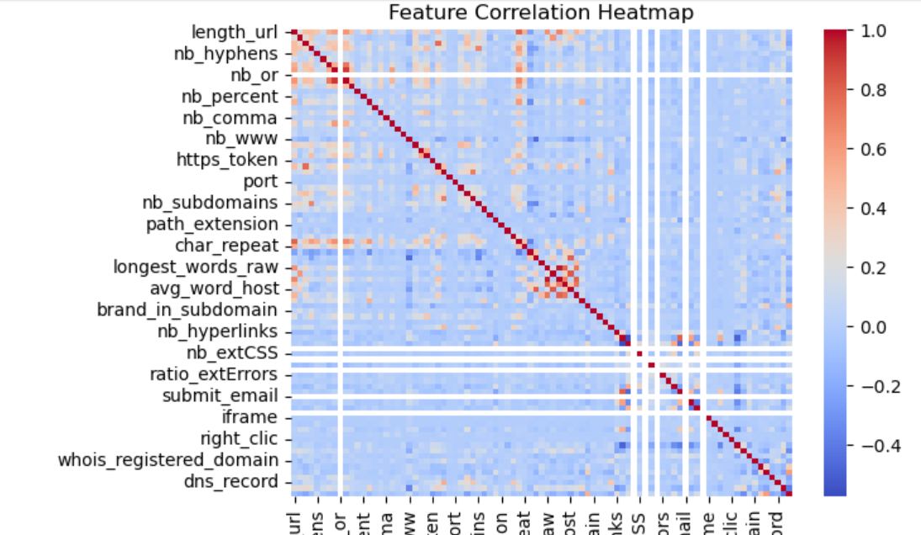
Key Insight : Heatmap showing the feature correlation between numeric_data.
Important Correlations :
Presence of IP address in URL : Strongly associated with phishing.
Use of HTTPS: Legitimate sites more likely to use it.
Domain age: Phishing domains are often newly registered.
Feature Selection Insight :
Top influencing features based on correlation and model feature importance :
https_token, length_url, prefix_suffix, web_traffic, domain_age .

Slide 11


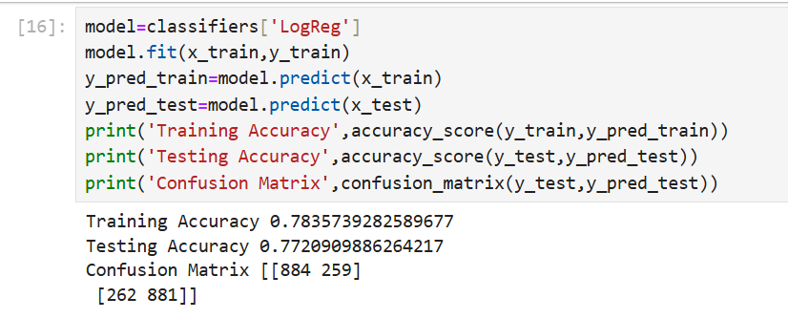
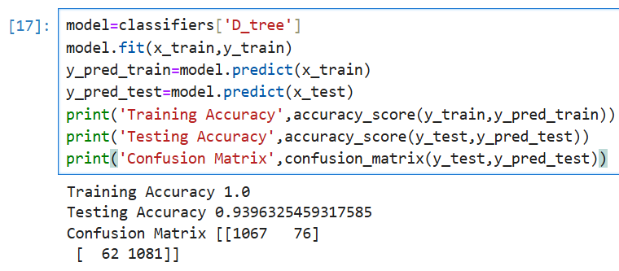
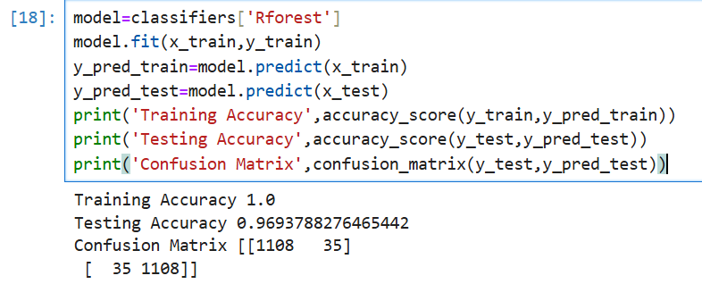
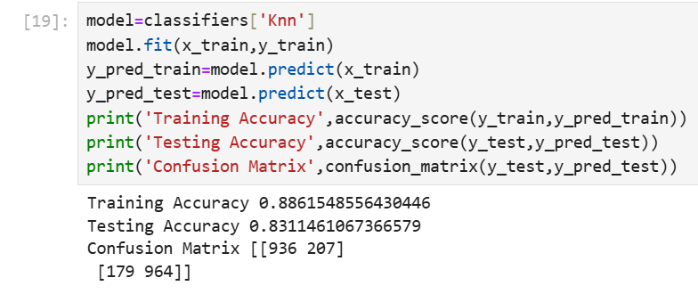
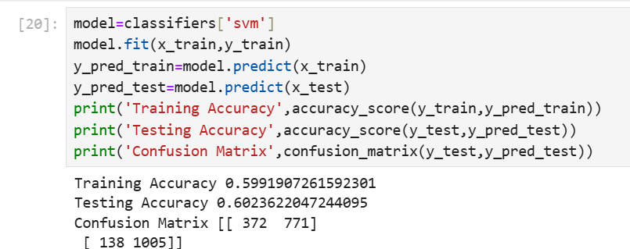
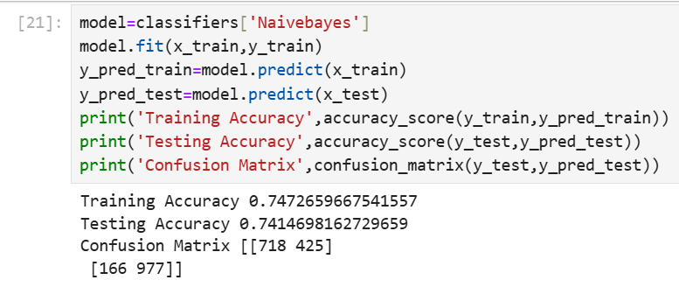
By Using Logistic Regression :
By Using Decision Tree :
By Using Random Forest :
By Using KNN Imputer :
By Using SVM :
By Using Naïve Bayes :

Slide 12



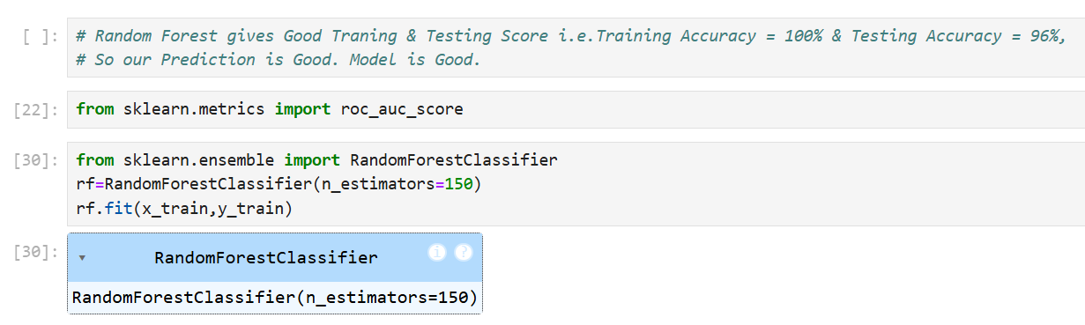
Evaluation :
Here, We have shown that, Random Forest has good Training & Testing Score.
It Gives Training Accuracy = 100% & Testing Accuracy = 96%.
I.e. Our Training & testing Accuracy is Good.
So, Our Prediction is Good. & Model is Good to Perform.

Slide 13



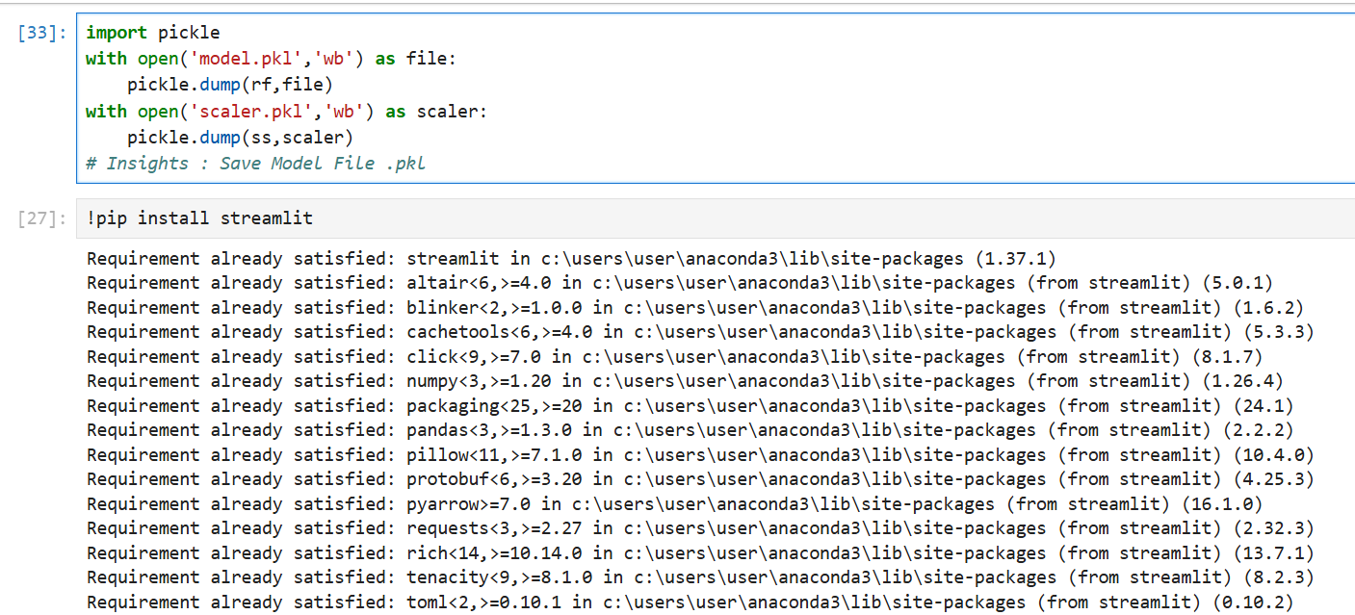
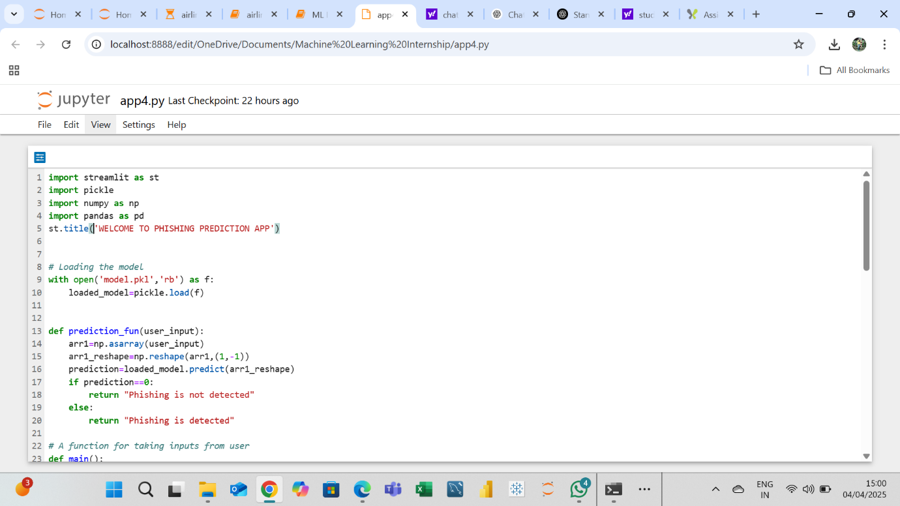
Import Pickle & Install Streamlit Library :
App4.Py File For Deployment :

Slide 14
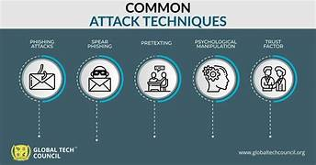
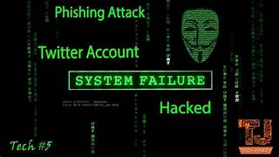
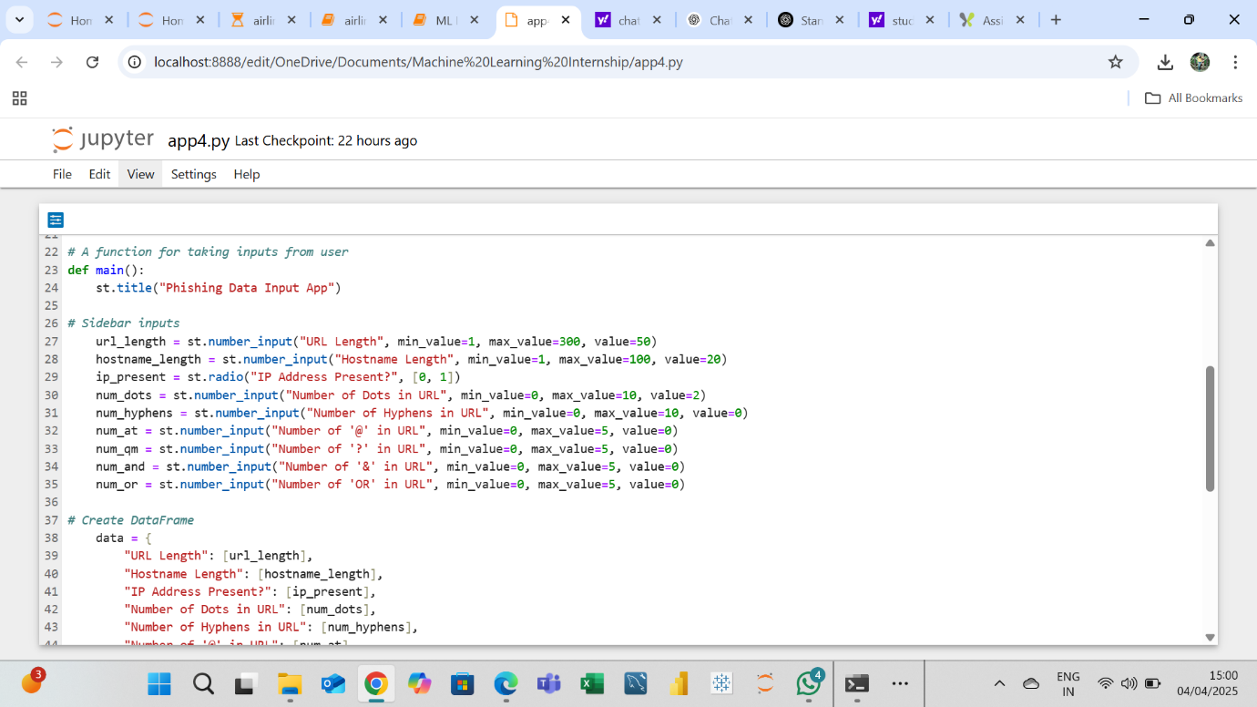
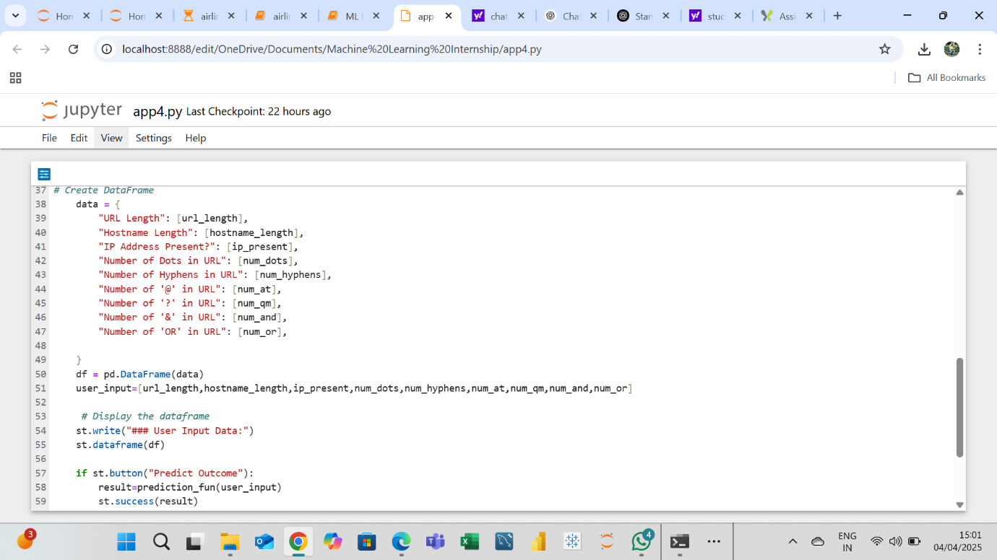
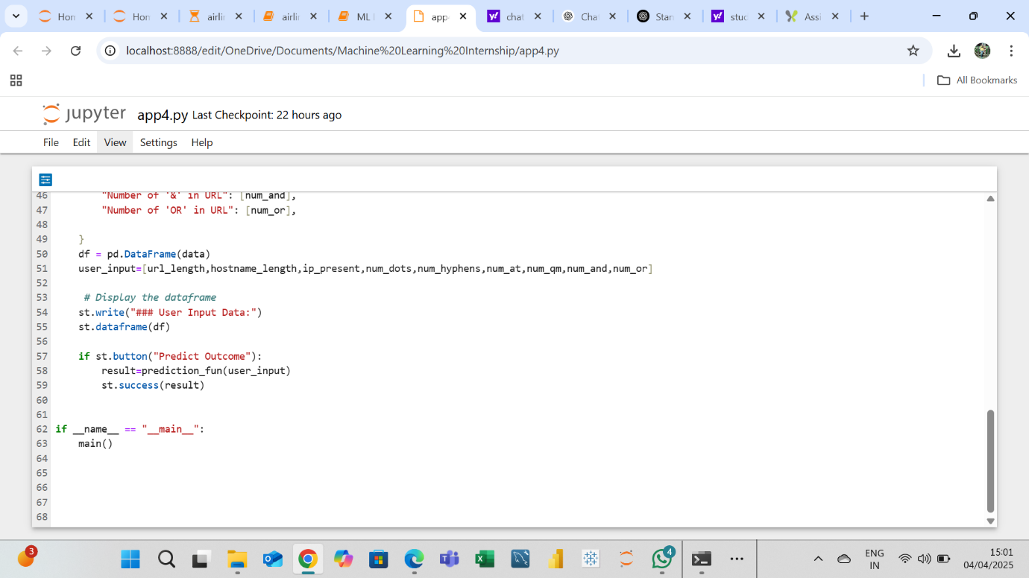
App4.Py File For Deployment :

Slide 15




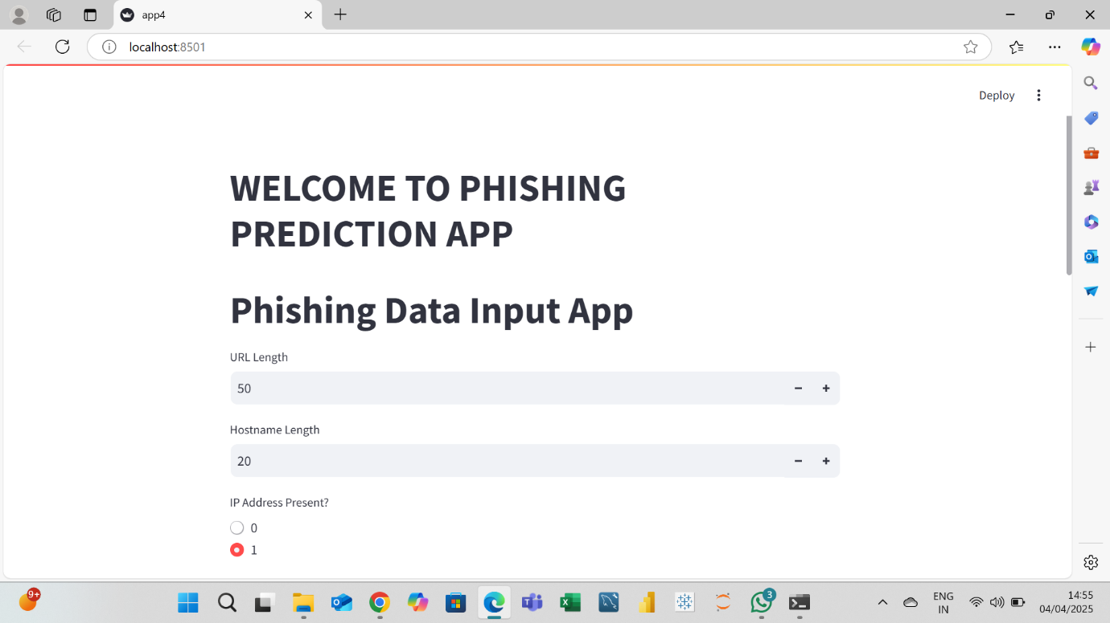
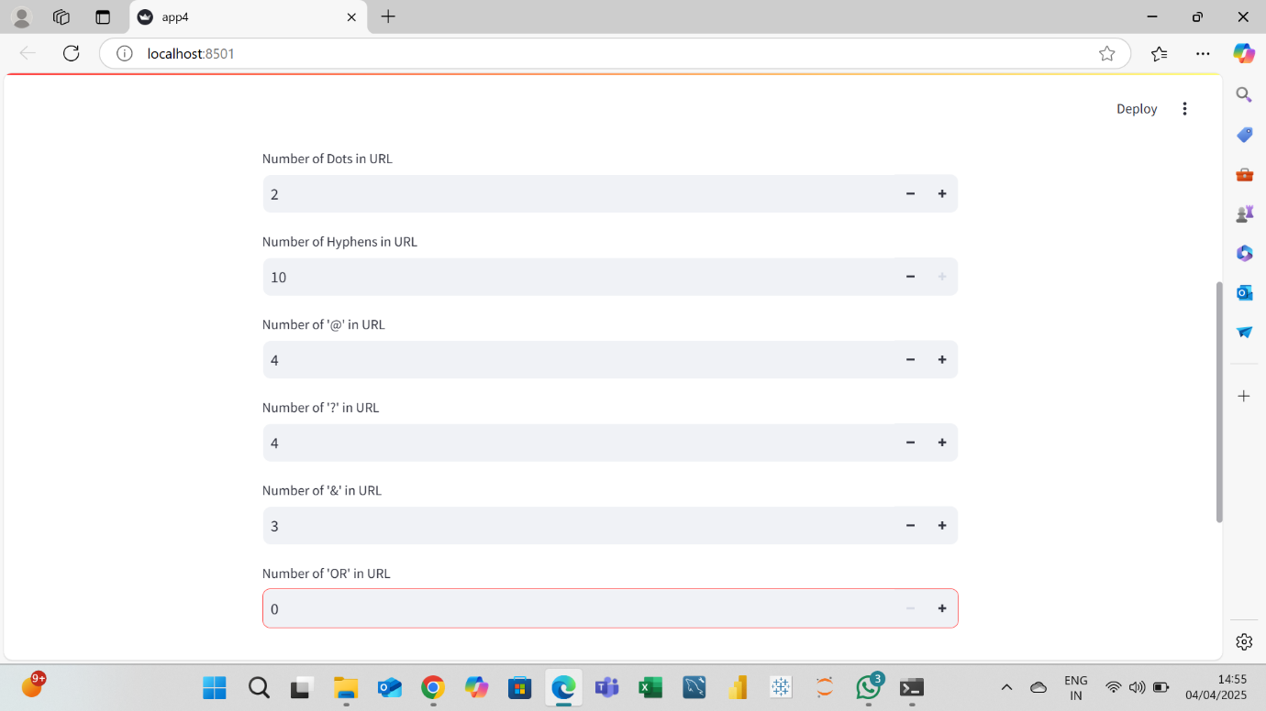
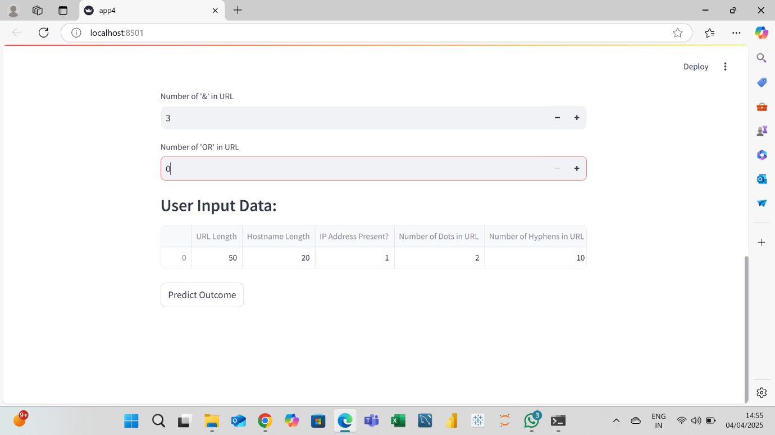
In this way, This is the Deployment Script Or Containarized Application Of Phishing Data.
This Whole is the Deployment Script Of the Model..

Slide 16


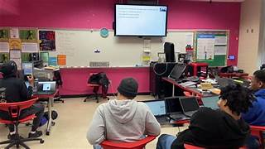
✅ Solving the Initial Problem: The model detects phishing websites with high accuracy before users interact with them. It provides a real-time, automated solution, reducing dependence on manually updated blacklists or browser alerts. Enhances overall cybersecurity posture for businesses and individuals by preventing data breaches and financial fraud.
🌐 Real-World Use Cases :
Browser Extension or Email Filters :
Automatically flags suspicious URLs in emails or on web pages.
Warns users before clicking on potentially harmful links.
Integration with Enterprise Security Systems :
Can be embedded into firewalls or proxy servers to block malicious domains.
Useful for companies to protect employee access to external websites.
Education and Awareness Tools :
Visual explanations help users understand what makes a URL suspicious.
Can be part of cybersecurity awareness programs.

Slide 17


1. Data Quality Issues : Inconsistent feature formats: Some URL components required extensive cleaning and normalization. Missing values in critical fields like domain age or web traffic metrics. Class imbalance initially skewed model results, requiring resampling techniques.
⚖️ 2. Model Bias & Tuning :
Some models overfit to specific URL patterns, reducing generalization to unseen phishing sites.
Selecting features that balance accuracy and interpretability was tricky—complex models performed better but were harder to explain.
Needed iterative tuning and cross-validation to achieve stable results.
🚧 3. Deployment Struggles :
Encountered versioning issues between local model and deployment environment.
Deployment doing with Pickle module with streamlit library & using App.py4 file for Deployment. There are major problems are coming at the time of Deployment. Then, Deployment UI has been done.
🧠 Each challenge helped improve problem-solving, debugging skills and understanding of real-world deployment intricacies.

Slide 18

🛠️ Technical Skills Acquired : Python & Data Science: Data preprocessing, feature engineering, and ML model building using libraries like pandas, Numpy,Matplotlib and Seaborn. Model Evaluation & Interpretation: Performance metrics, confusion matrix, ROC curve, and explainability Algorithms. Web Development: Built and deployed a Model-based API for real-time predictions. Containerization: Gained hands-on experience with Streamlit library, App4.py file & Anaconda Prompt for deployment.
🤝 Professional & Soft Skills ::
Collaboration: Worked with mentor feedback and incorporated suggestions to improve project quality.
Debugging & Problem-Solving: Resolved issues related to data inconsistency, model tuning, and deployment bugs.
Project Ownership: Gained experience in taking a project through the full machine learning lifecycle—from problem definition to deployment.
✅ This internship enhanced both my technical foundation and real-world readiness through hands-on project work and iterative learning.

Slide 19
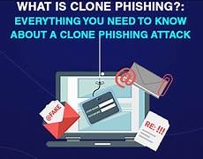

📝 Feedback Received :
Clarify objective and workflow in the early slides for better understanding.
Add more visuals to represent key metrics and model comparisons.
Improve explanation of evaluation metrics for non-technical audiences.
Simplify and structure content flow for better narrative and delivery.
Ensure real-world relevance is emphasized in business impact section.
🔧 Actions Taken :
Reworked Introduction and Workflow slides to clearly explain each phase.
Added charts, flow diagrams, and visual examples in EDA and Evaluation sections.
Included definitions and context for accuracy, recall, ROC curve, etc.
Polished slide layout and transitions for a more logical flow and visual consistency.
Expanded on use cases and deployment scenarios in business impact to show real-world value.
✅ The feedback significantly improved the quality, clarity, and professionalism of the final presentation.

Slide 20

🔍 Final Thoughts :
Successfully built an end-to-end phishing website detection system with high accuracy and practical deployment.
The project enhanced my understanding of the machine learning lifecycle, from data handling to real-world deployment.
🚀 Future Scope :
Expand feature set with real-time DNS lookup, SSL certificate analysis, and content-based features.
Integrate deep learning models for improved detection of advanced phishing techniques.
Deploy as a browser extension or integrate with existing security tools for broader impact.
🙏 Gratitude :
Sincere thanks to my mentor “Prajakta Talole MAM” for continuous support and constructive feedback.
Grateful for the opportunity to learn and grow through hands-on experience during this internship.
🎯 This project was a valuable stepping stone in my journey as a data science and cybersecurity enthusiast.

Slide 21


